Slide 1


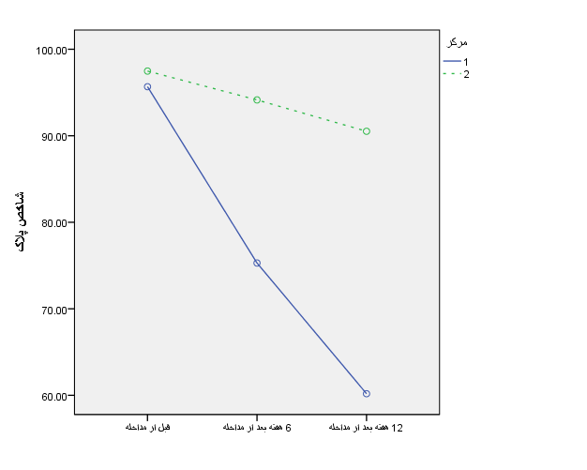
Oral Health Educational Programme of Intellectual Disabilities Children. Amir Fahimipour*
Background: Intellectual disability patients are one of those groups who needs attention in our societies more than others. The ID Children have more medical and dental complications than others. The purpose of this study on a selected group of disabled children was provided the effectiveness of oral health education to the caregivers of intellectually disabled children than a group of children under supervision of un-trained caregivers.
Materials and Methods: The study is a cluster randomized community trial with an institution as the unit of randomization. Two childcares accommodating a total of 16 caregivers and 72 children (aged 6 to 16) are randomly allocated to case or control groups. At this randomized control trial study, trained dental caregivers were randomly selected as the case group and non-trained caregivers were selected as the control group. Both the groups were observed over a period of two years and the results were recorded. Determination of the status of plaque index and DMFS /dmfs in the three different follows-up (eight, sixteen and twenty-four months) intervals were done after the initial referral. In each session, changes were recorded and after that the case group were trained in “Bass” brushing technique.
Result: There was no statically significant difference between the two groups with respect to average age (6-16, mean=11), sex(M), the food intake frequency and frequency of sugar intakes. They have almost the same meals and snacks and it was 5 times per day. The same brushes and pastes were provided during these two years for all the two child-cares. Research data are gathered at baseline and three follows up sessions at 8, 16 and 24 months after the start of the study. The training of supervisors in one childcare has been done by the main investigator of the study and monitored by second and third author of this article. Based on the results of this study changes in the process of decay and DMFS / dmfs in the case group of children have been the same, due to the time limit of two years. By checking the Plaque Index in both groups of children, 30% decrease in plaque index were observed in the intervention group.
Plaque index (%)
8. 16. 24 (Months)
Conclusion: The results of this study showed that oral health education for caregivers in childcare centres could lead to improvement of oral and dental health in children with intellectual disability.
References: 1. Nam-Ki chi, Kyu-Ho yang. A study on the dental disease of the handicapped. J Dent Child 2003; 70:153-158. 2. Mouradian WE. The face of a child: chil- dren’s oral health and dental education. J Dent Educ 2001; 65:821-310 3. Francis JR, Stevenson DR, Palmer JD. Den- tal health and dental care requirements for young handicapped adults in Wessex. Com- munity Dent Health 1991; 8:131-7. 4. Arnrup K, Lundin SA, Dahllof G. Analysis of paediatric dental services provided at a re- gional hospital in Sweden. Dental treatment need in medically compromised children re- ferred for dental consulation. Swed Dent J 1993; 17:255-9. 5. World health organization. Oral Health Sur- vey: Basic Methods, 3rd ed. Geneva: WHO, 1987. 6. Green JC, Vermillion JR. The simplified oral hygiene index. J Am Dent Assoc 1964; 68:7-13. 7. Lindhe J. Textbook of Clinical Periodontol- ogy. Copenhagen: Munksgaard; 1983:139-192. 8. Nunn J, Gordon P, Carmichael C. Dental disease and current treatment needs in a group of physically handicapped children. Commu- nity Dent Health 1993; 10:389-96. 9. Alavi AA, Amirhakimi E, Karami B. The prevalence of dental caries in 5-18-year-old insuline-dependent diabetics of Fars Province, Southern Iran. Arch Iran Med 2006; 9:245-60.

